Slide 1
Lecture 07 Abstract Data Type Stack and Queue (Array-based Implementation]
CSE225: Data Structures and Algorithms

Slide 2


Stack
A list
Data items can be added and deleted
Maintains Last In First Out (LIFO) order

Slide 3
Specification of StackType
Structure: | Elements are added to and removed from the top of the stack.
Definitions (provided by user):
MAX_ITEMS | Maximum number of items that might be on the stack.
ItemType | Data type of the items on the stack.
Operations (provided by the ADT):
MakeEmpty
Function | Sets stack to an empty state.
Postcondition | Stack is empty.
Boolean IsEmpty
Function | Determines whether the stack is empty.
Precondition | Stack has been initialized.
Postcondition | Returns true if stack is empty and false otherwise.
Boolean IsFull
Function | Determines whether the stack is full.
Precondition | Stack has been initialized.
Postcondition | Returns true if stack is full and false otherwise.

Slide 4
Specification of StackType
Push(ItemType newItem)
Function | Adds newItem to the top of the stack.
Precondition | Stack has been initialized.
Postcondition | If (stack is full), exception FullStack is thrown, else newItem is at the top of the stack.
Pop()
Function | Removes top item from the stack.
Precondition | Stack has been initialized.
Postcondition | If (stack is empty), exception EmptyStack is thrown, else top element has been removed from stack.
ItemType Top()
Function | Returns a copy of the top item on the stack.
Precondition | Stack has been initialized.
Postcondition | If (stack is empty), exception EmptyStack is thrown, else a copy of the top element is returned.

Slide 5
stacktype.h
#ifndef STACKTYPE_H_INCLUDED
#define STACKTYPE_H_INCLUDED
const int MAX_ITEMS = 5;
class FullStack
{}; // Exception class thrown by Push when stack is full.
class EmptyStack
{}; // Exception class thrown by Pop and Top when stack is empty.
template <class ItemType>
class StackType
{
public:
StackType();
bool IsFull();
bool IsEmpty();
void MakeEmpty();
void Push(ItemType);
void Pop();
ItemType Top();
private:
int top;
ItemType items[MAX_ITEMS];
};
#endif // STACKTYPE_H_INCLUDED

Slide 6
stacktype.cpp
#include "StackType.h"
template <class ItemType>
StackType<ItemType>::StackType()
{
top = -1;
}
template <class ItemType>
bool StackType<ItemType>::IsEmpty()
{
return (top == -1);
}
void StackType<ItemType>::MakeEmpty()
{
top = -1;
}
template <class ItemType>
bool StackType<ItemType>::IsFull()
{
return (top == MAX_ITEMS-1);
}
template <class ItemType>
void StackType<ItemType>::Push(ItemType newItem)
{
if( IsFull() )
throw FullStack();
top++;
items[top] = newItem;
}
template <class ItemType>
void StackType<ItemType>::Pop()
{
if( IsEmpty() )
throw EmptyStack();
top--;
}
template <class ItemType>
ItemType StackType<ItemType>::Top()
{
if (IsEmpty())
throw EmptyStack();
return items[top];
}

Slide 7
stacktype.cpp
#include "StackType.h"
template <class ItemType>
StackType<ItemType>::StackType()
{
top = -1;
}
template <class ItemType>
bool StackType<ItemType>::IsEmpty()
{
return (top == -1);
}
void StackType<ItemType>::MakeEmpty()
{
top = -1;
}
template <class ItemType>
bool StackType<ItemType>::IsFull()
{
return (top == MAX_ITEMS-1);
}
template <class ItemType>
void StackType<ItemType>::Push(ItemType newItem)
{
if( IsFull() )
throw FullStack();
top++;
items[top] = newItem;
}
template <class ItemType>
void StackType<ItemType>::Pop()
{
if( IsEmpty() )
throw EmptyStack();
top--;
}
template <class ItemType>
ItemType StackType<ItemType>::Top()
{
if (IsEmpty())
throw EmptyStack();
return items[top];
}
O(1)
O(1)
O(1)
O(1)
O(1)
O(1)
O(1)

Slide 8
Application of Stack
()
(())()(()())()
(())()((()
(())))((()
Which of the strings of parentheses are balanced?

Slide 9
Application of Stack
Algorithm for matching parentheses string
Initialise an empty stack
Read next item in the string
If item is an opening parentheses, push it into the stack
Else, if item is a closing parentheses, pop from stack
If there are more items to process, go to step 2
Pop the answer off the stack.

Slide 10
Application of Stack
(())()(()())()

Slide 11
Application of Stack
(())()(()())()
string
( | ( | ) | ) | ( | ) | ( | ( | ) | ( | ) | ) | ( | )
stack

Slide 12
Application of Stack
string
( | ( | ) | ) | ( | ) | ( | ( | ) | ( | ) | ) | ( | )
stack
(

Slide 13
Application of Stack
string
( | ( | ) | ) | ( | ) | ( | ( | ) | ( | ) | ) | ( | )
stack
( | (

Slide 14
Application of Stack
string
( | ( | ) | ) | ( | ) | ( | ( | ) | ( | ) | ) | ( | )
stack
(

Slide 15
Application of Stack
string
( | ( | ) | ) | ( | ) | ( | ( | ) | ( | ) | ) | ( | )
stack

Slide 16
Application of Stack
string
( | ( | ) | ) | ( | ) | ( | ( | ) | ( | ) | ) | ( | )
stack
(

Slide 17
Application of Stack
string
( | ( | ) | ) | ( | ) | ( | ( | ) | ( | ) | ) | ( | )
stack

Slide 18
Application of Stack
string
( | ( | ) | ) | ( | ) | ( | ( | ) | ( | ) | ) | ( | )
stack
(

Slide 19
Application of Stack
string
( | ( | ) | ) | ( | ) | ( | ( | ) | ( | ) | ) | ( | )
stack
( | (

Slide 20
Application of Stack
string
( | ( | ) | ) | ( | ) | ( | ( | ) | ( | ) | ) | ( | )
stack
(

Slide 21
Application of Stack
string
( | ( | ) | ) | ( | ) | ( | ( | ) | ( | ) | ) | ( | )
stack
( | (

Slide 22
Application of Stack
string
( | ( | ) | ) | ( | ) | ( | ( | ) | ( | ) | ) | ( | )
stack
(

Slide 23
Application of Stack
string
( | ( | ) | ) | ( | ) | ( | ( | ) | ( | ) | ) | ( | )
stack

Slide 24
Application of Stack
string
( | ( | ) | ) | ( | ) | ( | ( | ) | ( | ) | ) | ( | )
stack
(

Slide 25
Application of Stack
string
( | ( | ) | ) | ( | ) | ( | ( | ) | ( | ) | ) | ( | )
stack

Slide 26
Application of Stack
string
( | ( | ) | ) | ( | ) | ( | ( | ) | ( | ) | ) | ( | )
stack
empty stack
Indicates balanced string of parentheses

Slide 27
Application of Stack
(())()((()
Consider this string. After processing each item, the stack is not empty.
stack
( | (
non-empty stack
Indicates unbalanced string of parentheses

Slide 28
Application of Stack
(())))((()
Consider this string. When processing indicated item, you are trying to pop from empty stack.
stack
unsuccessful pop
Indicates unbalanced string of parentheses

Slide 29
Application of Stack
Evaluating arithmatic expressions
Why ? No parentheses necessary !
Infix | Postfix | Evaluation
2 - 3 * 4 + 5 | 2 3 4 * - 5 + | -5
(2 - 3) * (4 + 5) | 2 3 - 4 5 + * | -9
2- (3 * 4 +5) | 2 3 4 * 5 + - | -15

Slide 30
Application of Stack
Algorithm for Infix to Postfix
Examine the next element in the input.
If it is operand, output it.
If it is opening parenthesis, push it on stack.
If it is an operator, then
Pop until the top of the stack has an element of lower precedence
Then push it
If it is a closing parenthesis, pop operators from stack and output them until an opening parenthesis is encountered. pop and discard the opening parenthesis.
If there is more input go to step 1
If there is no more input, pop the remaining operators to output.

Slide 31
Application of Stack
Suppose we want to convert
(4+8)*(6-5)/((3-2)*(2+2))into Postfix form

Slide 32
Application of Stack
Infix
( | 4 | + | 8 | ) | * | ( | 6 | - | 5 | ) | / | ( | ( | 3 | - | 2 | ) | * | ( | 2 | + | 2 | ) | )
Stack
Postfix

Slide 33
Application of Stack
Infix
( | 4 | + | 8 | ) | * | ( | 6 | - | 5 | ) | / | ( | ( | 3 | - | 2 | ) | * | ( | 2 | + | 2 | ) | )
Stack
(
Postfix

Slide 34
Application of Stack
Infix
( | 4 | + | 8 | ) | * | ( | 6 | - | 5 | ) | / | ( | ( | 3 | - | 2 | ) | * | ( | 2 | + | 2 | ) | )
Stack
(
Postfix
4

Slide 35
Application of Stack
Infix
( | 4 | + | 8 | ) | * | ( | 6 | - | 5 | ) | / | ( | ( | 3 | - | 2 | ) | * | ( | 2 | + | 2 | ) | )
Stack
( | +
Postfix
4

Slide 36
Application of Stack
Infix
( | 4 | + | 8 | ) | * | ( | 6 | - | 5 | ) | / | ( | ( | 3 | - | 2 | ) | * | ( | 2 | + | 2 | ) | )
Stack
( | +
Postfix
4 | 8

Slide 37
Application of Stack
Infix
( | 4 | + | 8 | ) | * | ( | 6 | - | 5 | ) | / | ( | ( | 3 | - | 2 | ) | * | ( | 2 | + | 2 | ) | )
Stack
Postfix
4 | 8 | +

Slide 38
Application of Stack
Infix
( | 4 | + | 8 | ) | * | ( | 6 | - | 5 | ) | / | ( | ( | 3 | - | 2 | ) | * | ( | 2 | + | 2 | ) | )
Stack
*
Postfix
4 | 8 | +

Slide 39
Application of Stack
Infix
( | 4 | + | 8 | ) | * | ( | 6 | - | 5 | ) | / | ( | ( | 3 | - | 2 | ) | * | ( | 2 | + | 2 | ) | )
Stack
* | (
Postfix
4 | 8 | +

Slide 40
Application of Stack
Infix
( | 4 | + | 8 | ) | * | ( | 6 | - | 5 | ) | / | ( | ( | 3 | - | 2 | ) | * | ( | 2 | + | 2 | ) | )
Stack
* | (
Postfix
4 | 8 | + | 6

Slide 41
Application of Stack
Infix
( | 4 | + | 8 | ) | * | ( | 6 | - | 5 | ) | / | ( | ( | 3 | - | 2 | ) | * | ( | 2 | + | 2 | ) | )
Stack
* | ( | -
Postfix
4 | 8 | + | 6

Slide 42
Application of Stack
Infix
( | 4 | + | 8 | ) | * | ( | 6 | - | 5 | ) | / | ( | ( | 3 | - | 2 | ) | * | ( | 2 | + | 2 | ) | )
Stack
* | ( | -
Postfix
4 | 8 | + | 6 | 5

Slide 43
Application of Stack
Infix
( | 4 | + | 8 | ) | * | ( | 6 | - | 5 | ) | / | ( | ( | 3 | - | 2 | ) | * | ( | 2 | + | 2 | ) | )
Stack
*
Postfix
4 | 8 | + | 6 | 5 | -

Slide 44
Application of Stack
Infix
( | 4 | + | 8 | ) | * | ( | 6 | - | 5 | ) | / | ( | ( | 3 | - | 2 | ) | * | ( | 2 | + | 2 | ) | )
Stack
/
Postfix
4 | 8 | + | 6 | 5 | - | *

Slide 45
Application of Stack
Infix
( | 4 | + | 8 | ) | * | ( | 6 | - | 5 | ) | / | ( | ( | 3 | - | 2 | ) | * | ( | 2 | + | 2 | ) | )
Stack
/ | (
Postfix
4 | 8 | + | 6 | 5 | - | *

Slide 46
Application of Stack
Infix
( | 4 | + | 8 | ) | * | ( | 6 | - | 5 | ) | / | ( | ( | 3 | - | 2 | ) | * | ( | 2 | + | 2 | ) | )
Stack
/ | ( | (
Postfix
4 | 8 | + | 6 | 5 | - | *

Slide 47
Application of Stack
Infix
( | 4 | + | 8 | ) | * | ( | 6 | - | 5 | ) | / | ( | ( | 3 | - | 2 | ) | * | ( | 2 | + | 2 | ) | )
Stack
/ | ( | (
Postfix
4 | 8 | + | 6 | 5 | - | * | 3

Slide 48
Application of Stack
Infix
( | 4 | + | 8 | ) | * | ( | 6 | - | 5 | ) | / | ( | ( | 3 | - | 2 | ) | * | ( | 2 | + | 2 | ) | )
Stack
/ | ( | ( | -
Postfix
4 | 8 | + | 6 | 5 | - | * | 3

Slide 49
Application of Stack
Infix
( | 4 | + | 8 | ) | * | ( | 6 | - | 5 | ) | / | ( | ( | 3 | - | 2 | ) | * | ( | 2 | + | 2 | ) | )
Stack
/ | ( | ( | -
Postfix
4 | 8 | + | 6 | 5 | - | * | 3 | 2

Slide 50
Application of Stack
Infix
( | 4 | + | 8 | ) | * | ( | 6 | - | 5 | ) | / | ( | ( | 3 | - | 2 | ) | * | ( | 2 | + | 2 | ) | )
Stack
/ | (
Postfix
4 | 8 | + | 6 | 5 | - | * | 3 | 2 | -

Slide 51
Application of Stack
Infix
( | 4 | + | 8 | ) | * | ( | 6 | - | 5 | ) | / | ( | ( | 3 | - | 2 | ) | * | ( | 2 | + | 2 | ) | )
Stack
/ | ( | *
Postfix
4 | 8 | + | 6 | 5 | - | * | 3 | 2 | -

Slide 52
Application of Stack
Infix
( | 4 | + | 8 | ) | * | ( | 6 | - | 5 | ) | / | ( | ( | 3 | - | 2 | ) | * | ( | 2 | + | 2 | ) | )
Stack
/ | ( | * | (
Postfix
4 | 8 | + | 6 | 5 | - | * | 3 | 2 | -

Slide 53
Application of Stack
Infix
( | 4 | + | 8 | ) | * | ( | 6 | - | 5 | ) | / | ( | ( | 3 | - | 2 | ) | * | ( | 2 | + | 2 | ) | )
Stack
/ | ( | * | (
Postfix
4 | 8 | + | 6 | 5 | - | * | 3 | 2 | - | 2

Slide 54
Application of Stack
Infix
( | 4 | + | 8 | ) | * | ( | 6 | - | 5 | ) | / | ( | ( | 3 | - | 2 | ) | * | ( | 2 | + | 2 | ) | )
Stack
/ | ( | * | ( | +
Postfix
4 | 8 | + | 6 | 5 | - | * | 3 | 2 | - | 2

Slide 55
Application of Stack
Infix
( | 4 | + | 8 | ) | * | ( | 6 | - | 5 | ) | / | ( | ( | 3 | - | 2 | ) | * | ( | 2 | + | 2 | ) | )
Stack
/ | ( | * | ( | +
Postfix
4 | 8 | + | 6 | 5 | - | * | 3 | 2 | - | 2 | 2

Slide 56
Application of Stack
Infix
( | 4 | + | 8 | ) | * | ( | 6 | - | 5 | ) | / | ( | ( | 3 | - | 2 | ) | * | ( | 2 | + | 2 | ) | )
Stack
/ | ( | *
Postfix
4 | 8 | + | 6 | 5 | - | * | 3 | 2 | - | 2 | 2 | +

Slide 57
Application of Stack
Infix
( | 4 | + | 8 | ) | * | ( | 6 | - | 5 | ) | / | ( | ( | 3 | - | 2 | ) | * | ( | 2 | + | 2 | ) | )
Stack
/
Postfix
4 | 8 | + | 6 | 5 | - | * | 3 | 2 | - | 2 | 2 | + | *

Slide 58
Application of Stack
Infix
( | 4 | + | 8 | ) | * | ( | 6 | - | 5 | ) | / | ( | ( | 3 | - | 2 | ) | * | ( | 2 | + | 2 | ) | )
Stack
Postfix
4 | 8 | + | 6 | 5 | - | * | 3 | 2 | - | 2 | 2 | + | * | /

Slide 59
Application of Stack
Now let’s evaluate this expression.
4 8 + 6 5 - * 3 2 – 2 2 + * /

Slide 60
Application of Stack
Algorithm for evaluating a postfix expression
Initialise an empty stack
Read next item in the expression
If item is an operand, push it into the stack
Else, if item is an operator, pop top two items off the stack, apply the operator, and push the answer back into the stack
If there are more items to process, go to step 2
Pop the answer off the stack.

Slide 61
Application of Stack
string
4 | 8 | + | 6 | 5 | - | * | 3 | 2 | - | 2 | 2 | + | * | /
stack

Slide 62
Application of Stack
string
4 | 8 | + | 6 | 5 | - | * | 3 | 2 | - | 2 | 2 | + | * | /
stack
4

Slide 63
Application of Stack
string
4 | 8 | + | 6 | 5 | - | * | 3 | 2 | - | 2 | 2 | + | * | /
stack
4 | 8

Slide 64
Application of Stack
string
4 | 8 | + | 6 | 5 | - | * | 3 | 2 | - | 2 | 2 | + | * | /
stack
12

Slide 65
Application of Stack
string
4 | 8 | + | 6 | 5 | - | * | 3 | 2 | - | 2 | 2 | + | * | /
stack
12 | 6

Slide 66
Application of Stack
string
4 | 8 | + | 6 | 5 | - | * | 3 | 2 | - | 2 | 2 | + | * | /
stack
12 | 6 | 5

Slide 67
Application of Stack
string
4 | 8 | + | 6 | 5 | - | * | 3 | 2 | - | 2 | 2 | + | * | /
stack
12 | 1

Slide 68
Application of Stack
string
4 | 8 | + | 6 | 5 | - | * | 3 | 2 | - | 2 | 2 | + | * | /
stack
12

Slide 69
Application of Stack
string
4 | 8 | + | 6 | 5 | - | * | 3 | 2 | - | 2 | 2 | + | * | /
stack
12 | 3

Slide 70
Application of Stack
string
4 | 8 | + | 6 | 5 | - | * | 3 | 2 | - | 2 | 2 | + | * | /
stack
12 | 3 | 2

Slide 71
Application of Stack
string
4 | 8 | + | 6 | 5 | - | * | 3 | 2 | - | 2 | 2 | + | * | /
stack
12 | 1

Slide 72
Application of Stack
string
4 | 8 | + | 6 | 5 | - | * | 3 | 2 | - | 2 | 2 | + | * | /
stack
12 | 1 | 2

Slide 73
Application of Stack
string
4 | 8 | + | 6 | 5 | - | * | 3 | 2 | - | 2 | 2 | + | * | /
stack
12 | 1 | 2 | 2

Slide 74
Application of Stack
string
4 | 8 | + | 6 | 5 | - | * | 3 | 2 | - | 2 | 2 | + | * | /
stack
12 | 1 | 4

Slide 75
Application of Stack
string
4 | 8 | + | 6 | 5 | - | * | 3 | 2 | - | 2 | 2 | + | * | /
stack
12 | 4

Slide 76
Application of Stack
string
4 | 8 | + | 6 | 5 | - | * | 3 | 2 | - | 2 | 2 | + | * | /
stack
3

Slide 77
Application of Stack
Only item in stack: indicates valid expression
stack
3
More than one item in stack or unsuccessful pop: indicates invalid expression

Slide 78

Queue
A list
Data items can be added and deleted
Maintains First In First Out (FIFO) order

Slide 79
Specification of QueueType
Structure: | Elements are added to the rear and removed from the front of the queue.
Definitions (provided by user):
MAX_ITEMS | Maximum number of items that might be on the queue.
ItemType | Data type of the items on the queue.
Operations (provided by the ADT):
MakeEmpty
Function | Sets stack to an empty state.
Postcondition | Stack is empty.
Boolean IsEmpty
Function | Determines whether the stack is empty.
Precondition | Stack has been initialized.
Postcondition | Returns true if stack is empty and false otherwise.
Boolean IsFull
Function | Determines whether the stack is full.
Precondition | Stack has been initialized.
Postcondition | Returns true if stack is full and false otherwise.

Slide 80
Specification of QueueType
Enqueue(ItemType newItem)
Function | Adds newItem to the rear of the queue.
Precondition | Queue has been initialized.
Postcondition | If (queue is full), FullQueue exception is thrown, else newItem is at rear of queue.
Dequeue(ItemType& item)
Function | Removes front item from the queue and returns it in item.
Precondition | Queue has been initialized.
Postcondition | If (queue is empty), EmptyQueue exception is thrown and item is undefined, else front element has been removed from queue and item is a copy of removed element.

Slide 81
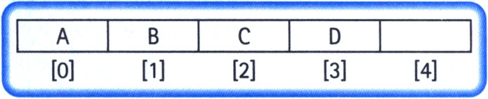
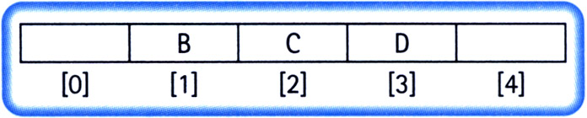
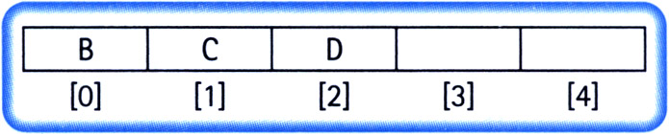
Implementation Issues
Always insert elements at the back of the array.
Complexity of deletion: O(N)

Slide 82
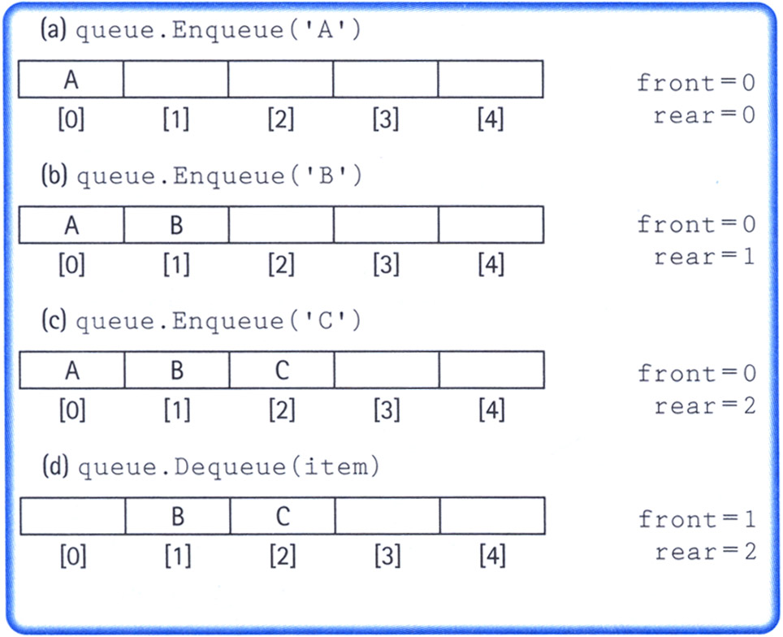
Implementation Issues
Maintain two indices: front and rear
Increment the indices as additions and deletions are performed (rear++ for addition and front++ for deletion)
Dead space

Slide 83
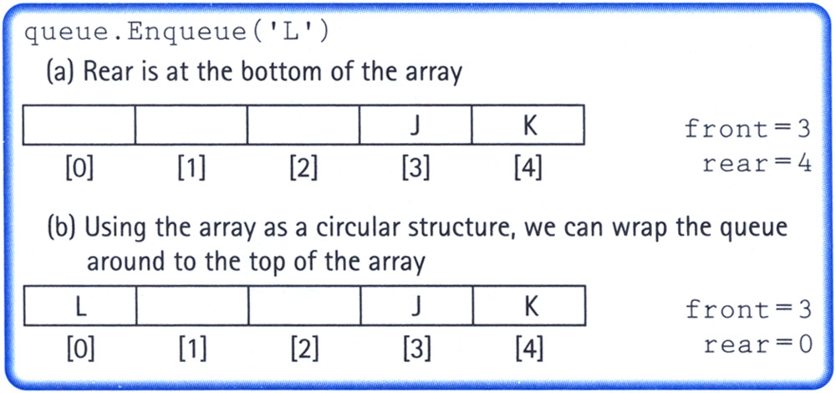
Implementation Issues
Maintain two indices: front and rear
Make the indices “wrap around” when they reach the end of the array
rear = (rear + 1) % maxQue; //maxQue=size of array
front = (front + 1) % maxQue;

Slide 84
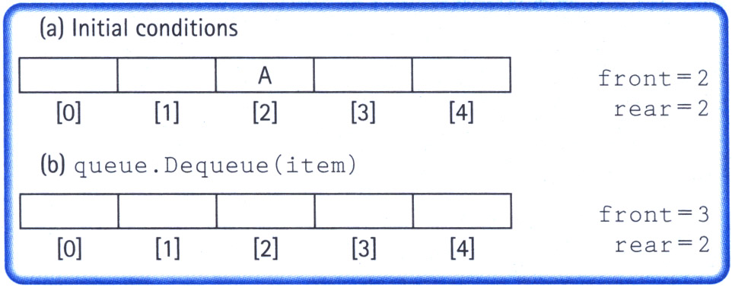
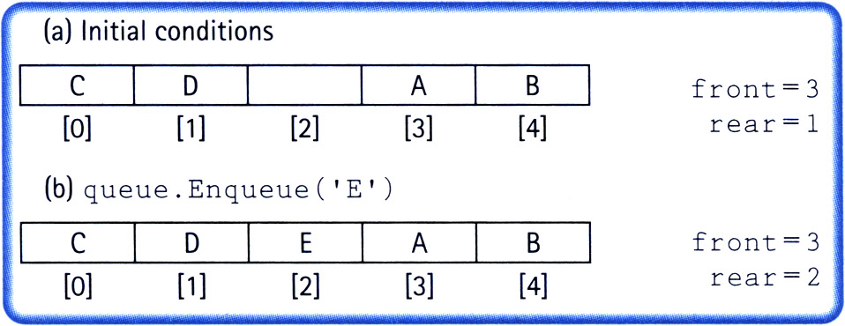
Implementation Issues
How do we differentiate between the empty state and the full state?

Slide 85
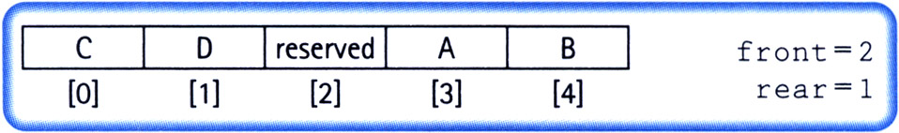
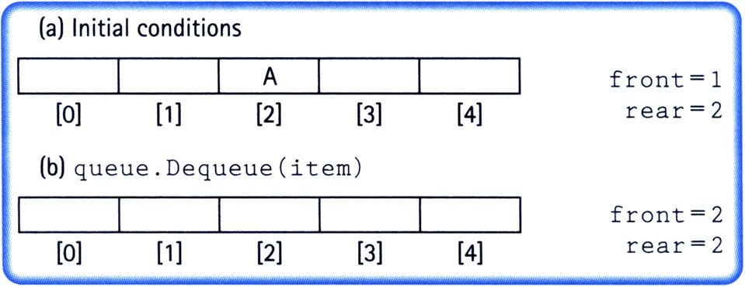
Implementation Issues
Let front indicate the index of the array slot preceding the front element.
The array slot preceding the front element is reserved and items are not assigned in that slot.

Slide 86
Implementation Issues
Full queue when (rear + 1) % maxQue == front
Empty queue when front == rear

Slide 87
queuetype.h
typedef char ItemType;
class FullQueue
{};
class EmptyQueue
{};
class QueType
{
public:
QueType();
QueType(int max);
~QueType();
void MakeEmpty();
bool IsEmpty();
bool IsFull();
void Enqueue(ItemType newItem);
void Dequeue(ItemType& item);
private:
int front;
int rear;
ItemType* items;
int maxQue;
};

Slide 88
queuetype.cpp
#include "QueType.h"
QueType::QueType(int max)
{
maxQue = max + 1;
front = maxQue - 1;
rear = maxQue - 1;
items = new ItemType[maxQue];
}
QueType::QueType()
{
maxQue = 501;
front = maxQue - 1;
rear = maxQue - 1;
items = new ItemType[maxQue];
}
QueType::~QueType()
{
delete [] items;
}
void QueType::MakeEmpty()
{
front = maxQue - 1;
rear = maxQue - 1;
}
bool QueType::IsEmpty()
{
return (rear == front);
}
bool QueType::IsFull()
{
return ((rear+1)%maxQue == front);
}

Slide 89
queuetype.cpp
void QueType::Enqueue(ItemType newItem)
{
if (IsFull())
throw FullQueue();
else
{
rear = (rear +1) % maxQue;
items[rear] = newItem;
}
}
void QueType::Dequeue(ItemType& item)
{
if (IsEmpty())
throw EmptyQueue();
else
{
front = (front + 1) % maxQue;
item = items[front];
}
}

Slide 90
queuetype.cpp
#include "QueType.h"
QueType::QueType(int max)
{
maxQue = max + 1;
front = maxQue - 1;
rear = maxQue - 1;
items = new ItemType[maxQue];
}
QueType::QueType()
{
maxQue = 501;
front = maxQue - 1;
rear = maxQue - 1;
items = new ItemType[maxQue];
}
QueType::~QueType()
{
delete [] items;
}
void QueType::MakeEmpty()
{
front = maxQue - 1;
rear = maxQue - 1;
}
bool QueType::IsEmpty()
{
return (rear == front);
}
bool QueType::IsFull()
{
return ((rear+1)%maxQue == front);
}
O(1)
O(1)
O(1)
O(1)
O(1)
O(1)

Slide 91
queuetype.cpp
void QueType::Enqueue(ItemType newItem)
{
if (IsFull())
throw FullQueue();
else
{
rear = (rear +1) % maxQue;
items[rear] = newItem;
}
}
void QueType::Dequeue(ItemType& item)
{
if (IsEmpty())
throw EmptyQueue();
else
{
front = (front + 1) % maxQue;
item = items[front];
}
}
O(1)
O(1)

Slide 92
An Application of Queue
You want to form a number N as a summation of smaller numbers
You can only use three prime numbers; 2, 3 and 5
You can use any of these three prime numbers as many times as you want
Can you find the minimum number of prime numbers required to do this?

Slide 93
An Application of Queue
Say N = 11
Possible solutions
2+2+2+5
3+3+5
2+2+2+2+3

Slide 94
An Application of Queue
N = 11
queue
0
cost
0

Slide 95
An Application of Queue
N = 11
queue
0
cost
0

Slide 96
An Application of Queue
N = 11
queue
0 | 2 | 3 | 5
cost
0 | 1 | 1 | 1

Slide 97
An Application of Queue
N = 11
queue
0 | 2 | 3 | 5
cost
0 | 1 | 1 | 1

Slide 98
An Application of Queue
N = 11
queue
0 | 2 | 3 | 5 | 4 | 5 | 7
cost
0 | 1 | 1 | 1 | 2 | 2 | 2

Slide 99
An Application of Queue
N = 11
queue
0 | 2 | 3 | 5 | 4 | 5 | 7
cost
0 | 1 | 1 | 1 | 2 | 2 | 2

Slide 100
An Application of Queue
N = 11
queue
0 | 2 | 3 | 5 | 4 | 5 | 7 | 5 | 6 | 8
cost
0 | 1 | 1 | 1 | 2 | 2 | 2 | 2 | 2 | 2

Slide 101
An Application of Queue
N = 11
queue
0 | 2 | 3 | 5 | 4 | 5 | 7 | 5 | 6 | 8
cost
0 | 1 | 1 | 1 | 2 | 2 | 2 | 2 | 2 | 2

Slide 102
An Application of Queue
N = 11
queue
0 | 2 | 3 | 5 | 4 | 5 | 7 | 5 | 6 | 8 | 7 | 8 | 10
cost
0 | 1 | 1 | 1 | 2 | 2 | 2 | 2 | 2 | 2 | 2 | 2 | 2

Slide 103
An Application of Queue
N = 11
queue
0 | 2 | 3 | 5 | 4 | 5 | 7 | 5 | 6 | 8 | 7 | 8 | 10
cost
0 | 1 | 1 | 1 | 2 | 2 | 2 | 2 | 2 | 2 | 2 | 2 | 2

Slide 104
An Application of Queue
N = 11
queue
0 | 2 | 3 | 5 | 4 | 5 | 7 | 5 | 6 | 8 | 7 | 8 | 10 | 6 | 7 | 9
cost
0 | 1 | 1 | 1 | 2 | 2 | 2 | 2 | 2 | 2 | 2 | 2 | 2 | 3 | 3 | 3

Slide 105
An Application of Queue
N = 11
queue
0 | 2 | 3 | 5 | 4 | 5 | 7 | 5 | 6 | 8 | 7 | 8 | 10 | 6 | 7 | 9
cost
0 | 1 | 1 | 1 | 2 | 2 | 2 | 2 | 2 | 2 | 2 | 2 | 2 | 3 | 3 | 3

Slide 106
An Application of Queue
N = 11
queue
0 | 2 | 3 | 5 | 4 | 5 | 7 | 5 | 6 | 8 | 7 | 8 | 10 | 6 | 7 | 9 | 7 | 8 | 10
cost
0 | 1 | 1 | 1 | 2 | 2 | 2 | 2 | 2 | 2 | 2 | 2 | 2 | 3 | 3 | 3 | 3 | 3 | 3

Slide 107
An Application of Queue
N = 11
queue
0 | 2 | 3 | 5 | 4 | 5 | 7 | 5 | 6 | 8 | 7 | 8 | 10 | 6 | 7 | 9 | 7 | 8 | 10
cost
0 | 1 | 1 | 1 | 2 | 2 | 2 | 2 | 2 | 2 | 2 | 2 | 2 | 3 | 3 | 3 | 3 | 3 | 3

Slide 108
An Application of Queue
N = 11
queue
0 | 2 | 3 | 5 | 4 | 5 | 7 | 5 | 6 | 8 | 7 | 8 | 10 | 6 | 7 | 9 | 7 | 8 | 10 | 9
10 | 12
cost
0 | 1 | 1 | 1 | 2 | 2 | 2 | 2 | 2 | 2 | 2 | 2 | 2 | 3 | 3 | 3 | 3 | 3 | 3 | 3
3 | 3

Slide 109
An Application of Queue
N = 11
queue
0 | 2 | 3 | 5 | 4 | 5 | 7 | 5 | 6 | 8 | 7 | 8 | 10 | 6 | 7 | 9 | 7 | 8 | 10 | 9
10 | 12
cost
0 | 1 | 1 | 1 | 2 | 2 | 2 | 2 | 2 | 2 | 2 | 2 | 2 | 3 | 3 | 3 | 3 | 3 | 3 | 3
3 | 3

Slide 110
An Application of Queue
N = 11
queue
0 | 2 | 3 | 5 | 4 | 5 | 7 | 5 | 6 | 8 | 7 | 8 | 10 | 6 | 7 | 9 | 7 | 8 | 10 | 9
10 | 12 | 7 | 8 | 10
cost
0 | 1 | 1 | 1 | 2 | 2 | 2 | 2 | 2 | 2 | 2 | 2 | 2 | 3 | 3 | 3 | 3 | 3 | 3 | 3
3 | 3 | 3 | 3 | 3

Slide 111
An Application of Queue
N = 11
queue
0 | 2 | 3 | 5 | 4 | 5 | 7 | 5 | 6 | 8 | 7 | 8 | 10 | 6 | 7 | 9 | 7 | 8 | 10 | 9
10 | 12 | 7 | 8 | 10
cost
0 | 1 | 1 | 1 | 2 | 2 | 2 | 2 | 2 | 2 | 2 | 2 | 2 | 3 | 3 | 3 | 3 | 3 | 3 | 3
3 | 3 | 3 | 3 | 3

Slide 112
An Application of Queue
N = 11
queue
0 | 2 | 3 | 5 | 4 | 5 | 7 | 5 | 6 | 8 | 7 | 8 | 10 | 6 | 7 | 9 | 7 | 8 | 10 | 9
10 | 12 | 7 | 8 | 10 | 8 | 9 | 11
cost
0 | 1 | 1 | 1 | 2 | 2 | 2 | 2 | 2 | 2 | 2 | 2 | 2 | 3 | 3 | 3 | 3 | 3 | 3 | 3
3 | 3 | 3 | 3 | 3 | 3 | 3 | 3

Slide 113
An Application of Queue
N = 11
queue
0 | 2 | 3 | 5 | 4 | 5 | 7 | 5 | 6 | 8 | 7 | 8 | 10 | 6 | 7 | 9 | 7 | 8 | 10 | 9
10 | 12 | 7 | 8 | 10 | 8 | 9 | 11
cost
0 | 1 | 1 | 1 | 2 | 2 | 2 | 2 | 2 | 2 | 2 | 2 | 2 | 3 | 3 | 3 | 3 | 3 | 3 | 3
3 | 3 | 3 | 3 | 3 | 3 | 3 | 3

